Slide 1
Lecture:4 Functions, Automatic inline functions, Object Pointers
Prepared By: Sumaiya Binte Shahid
Lecturer
Department of CSE, BUBT

Slide 2
Member function with Scope resolution operator ( :: )
In C++, the scope resolution operator is ::. It is used for the following purposes.
1) To access a global variable when there is a local variable with same name:
#include<iostream>
using namespace std;
int x; // Global x
int main()
{
int x = 10; // Local x
cout << "Value of global x is " << ::x;
cout << "\nValue of local x is " << x;
return 0;
}

Slide 3
Member function with Scope resolution operator ( :: )
In C++, the scope resolution operator is ::. It is used for the following purposes.
To define a function outside a class.
In case of multiple Inheritance.
Refer to a member of the base class in the derived object.
Refer to a class inside another class.

Slide 4
Member function with Scope resolution operator ( :: )
How to do that?
Return type of the function.
Class name
Scope resolution operator ::
Function name with parameter list.
Function body between {}
return_type class_name :: function_name()
{
//function body.
}

Slide 5
Member function with Scope resolution operator ( :: )
How to do that?
return_type class_name :: function_name()
{
//function body.
}
void Box :: print_volume()
{
//function body.
}

Slide 6
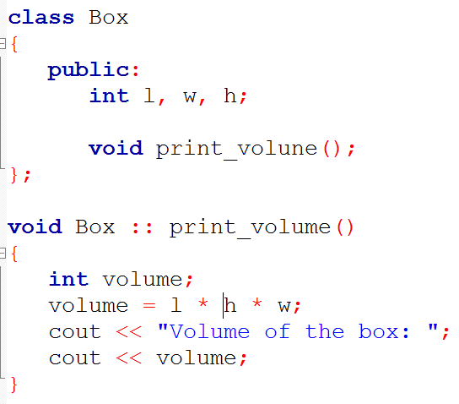
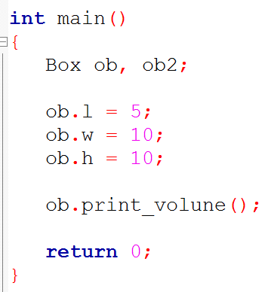
Member function with Scope resolution operator ( :: )

Slide 7
Object Pointer
So far, you have been accessing members of an object by using the dot operator.
However, it is also possible to access a member of an object via pointer to that object.
When a pointer is used, the arrow operator (->) rather than the dot operator is employed.

Slide 8
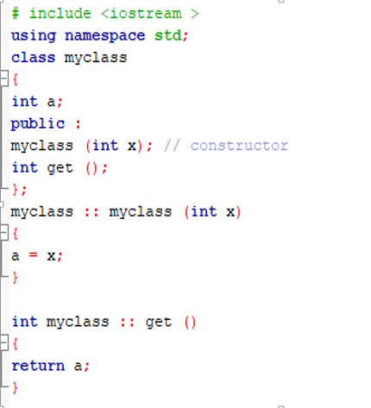
Object Pointer

Slide 9
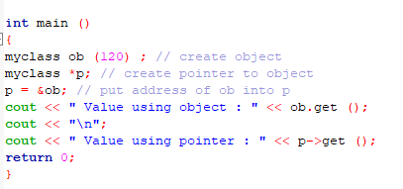

Object Pointer

Slide 10
Object Pointer
How the Declaration:
myclass *p;
creates a pointer to an object of myclass. It is important to understand that creation of an object pointer does not create an object, rather it creates just a pointer to one. The address of ob is put into p by using this statement:
p = &ob;
Finally, the program shows how the members of an object can be accessed through a pointer.

Slide 11
#include <iostream>
using namespace std;
struct varsity { // Creating a struct
int age; // Defining data members
char grade;
float GPA;
};
int main()
{
struct varsity student1;
student1.age = 25; // Assigning values to all data members
student1.grade = 'B';
student1.GPA = 4.5;
cout << "Age : " << student1.age << endl;
cout << "Grade : " << student1.grade << endl;
cout << "GPA : " << student1.GPA << endl;
return 0;
}
Structures in C++

Slide 12
Structures in C++
Output
Age : 25
Grade : B
GPA : 4.5
We have assigned the values to all data members in one go. Here, they share the different memory location and there is no chance of overwritten.

Slide 13
Classes vs. Structures in C++
Class | Structure
1. Members of a class are private by default. | 1. Members of a structure are public by default.
2. An instance of a class is called an ‘object’. | 2. An instance of structure is called the ‘structure variable’.
3. Member classes/structures of a class are private by default but not all programming languages have this default behavior eg Java etc. | 3. Member classes/structures of a structure are public by default.
4. It is declared using the class keyword. | 4. It is declared using the struct keyword.

Slide 14
Classes vs. Structures in C++
Class | Structure
5. It is normally used for data abstraction and further inheritance. | 5. It is normally used for the grouping of data.
6. NULL values are possible in Class. | 6. NULL values are not possible.
7. Syntax: class class_name { data_member; member_function; }; | 7. Syntax: struct structure_name { type structure_member1; type structure_member2; };

Slide 15
Classes vs. Structures in C++
Why Both Exist:
Compatibility with C: Structures in C++ maintain compatibility with C, where structure members are always public by default. This allows C-style structures to be used in C++ programs.
Flexibility: Although structures can do almost everything classes can, classes provide a more formal way to define complex objects with data and functions.
Common Practice:
Classes: Usually used when creating objects that include both data and behavior (functions).
Structures: Typically reserved for simpler data-only objects, similar to their use in C.

Slide 16
Unions in C++
In C++, a union is a user-defined datatype in which we can define members of different types of data types just like structures. But one thing that makes it different from structures is that the member variables in a union share the same memory location, unlike a structure that allocates memory separately for each member variable. The size of the union is equal to the size of the largest data type.
Syntax of Union in C++
union Union_Name {
// Declaration of data members
};
union_variables;

Slide 17
#include <iostream>
using namespace std;
union varsity {
int age;
char grade; // Defining data members
float GPA;
};
int main()
{
union varsity student1; // Defining a union variable
student1.age = 25;
cout << "Age : " << student1.age << endl;
student1.grade = 'B';
cout << "Grade : " << student1.grade << endl;
student1.GPA = 4.5;
cout << "GPA : " << student1.GPA << endl;
return 0;
}
Unions in C++

Slide 18
Unions in C++
Output
Age : 25
Grade : B
GPA : 4.5
We have not assigned the values to all data members in one go as we do normally because they share the same memory location and if we do so then their value will be overwritten.

Slide 19
Unions in C++
Shared Memory: All data members in a union share the same memory space, meaning only one member can hold a value at a time.
Function Members: Like structures, unions in C++ can include functions, but they have some restrictions.
Restrictions:
Unions can't inherit from other classes or serve as a base class.
Unions can't have static members.
Unions can't contain objects with constructors or destructors, although the union itself can have these functions.
Anonymous Unions: Special unions without a type name, allowing direct access to their members, which share the same memory space.

Slide 20
Why Inline Functions are Used?
When the program executes the function call instruction the CPU stores the memory address of the instruction following the function call, copies the arguments of the function on the stack, and finally transfers control to the specified function. The CPU then executes the function code, stores the function return value in a predefined memory location/register, and returns control to the calling function. This can become overhead if the execution time of the function is less than the switching time from the caller function to called function.
This problem can be solved by using inline function.

Slide 21
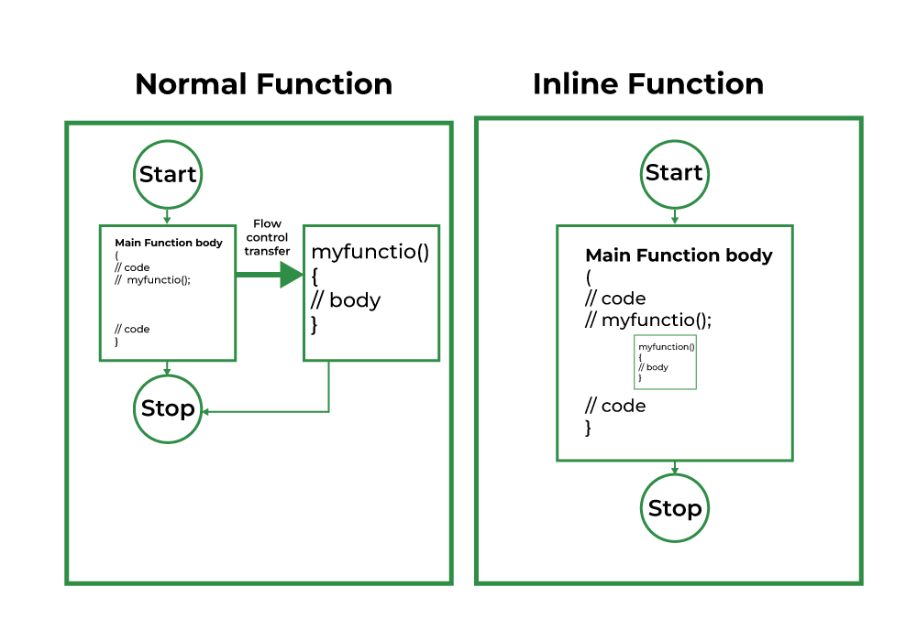
Why Inline Functions are Used?

Slide 22
Inline Function
When the inline function is called whole code of the inline function gets inserted or substituted at the point of the inline function call. And thus it reduces the memory space.
This substitution is performed by the C++ compiler at compile time.
An inline function may increase efficiency if it is small because the execution time of a small function is less than the switching time.

Slide 23
Inline Function
If a function is inline, the compiler places a copy of the code of that function at each point where the function is called at compile time.
Place the keyword inline before the function name.
An in-line function must be defined before it is first called. If it isn't, the compiler has no way to know that it is supposed to be expanded in-line.

Slide 24
Inline Function : Example
#include <iostream>
using namespace std;
inline int cube(int s) { return s * s * s; }
int main()
{
cout << "The cube of 3 is: " << cube(3) << "\n";
return 0;
}

Slide 25
Inline Function
Advantages
In-line functions can be executed much faster than normal functions.
Have no overhead association with the function call and return mechanism.
It also saves the overhead of push/pop variables on the stack when a function is called.
If function has parameter(s), even more time overhead is generated.
Disadvantages
If in-line functions are too large and called too often, our program grows larger.

Slide 26
Inline Function
The inline specifier is a request, not a commend to compiler. If any in-line restriction is violated, the compiler is free to generate a normal function.
Some compiler will not in-line a function if it contain
A static variable
A loop statement
A switch or a goto
If the function is recursive
If a function return type is other than void, and the return statement doesn’t exist in a function body.

Slide 27
Automatic Inlining
If a member function’s definition is short enough, the definition can be included inside the class declaration. Doing so cause the function is automatically become an in-line function.
If a function only has a few lines of code, the compiler might automatically inline it, meaning it puts that code directly into the calling code, rather than jumping to the function and then returning. However, the compiler makes this decision on its own, based on factors like function size and how often it's used.

Slide 28
Automatic Inlining
In this case the “inline” keyword is no longer necessary.
The same restrictions that apply to normal in-line functions apply to automatic in-line functions within a class declaration.
*** See Example on Reference Book (Chapter 2).

Slide 29
Define a class Animal with:
A private string variable sound.
A constructor that initializes variable with given value
A getter function (get()) that returns the value of sound
In the main() function: Create an object and initialize it . Declare a pointer pt to a Animal object. Store the address of the object in pt. Use the pointer (pt) to display the value of sound

Slide 30

Thank You

